Slide 1
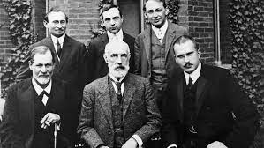
A brief history of psychology

Slide 2
Where did Psychology come from? (1)
Psychology traces its roots to ancient Greece
The earliest “psychologists” weren’t psychologists at all
  They were philosophers
Psychology didn’t organize as a science in the late 19th

Slide 3
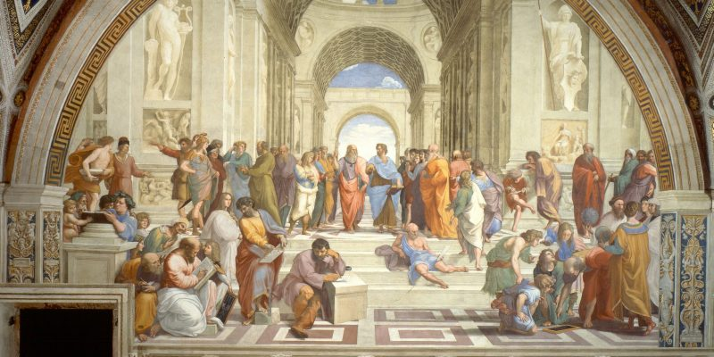
Where did Psychology come from? (2)
Western philosophy came of age in ancient Greece approximately 400 B.C
Early philosophers such as Socrates, Plato, and Aristotle debated the nature of thought and behavior

Slide 4
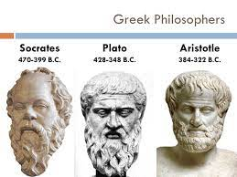
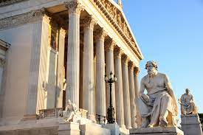
Where did Psychology come from? (3)
Many issues are still relevant in modern Psychology
  Plato: Nativism, the idea that behaviors and cognitive abilities are inborn
  Aristotle: Philosophical empiricism: Knowledge and learning occur through experience
  Hippocrates: Mind and body operate in unison

Slide 5
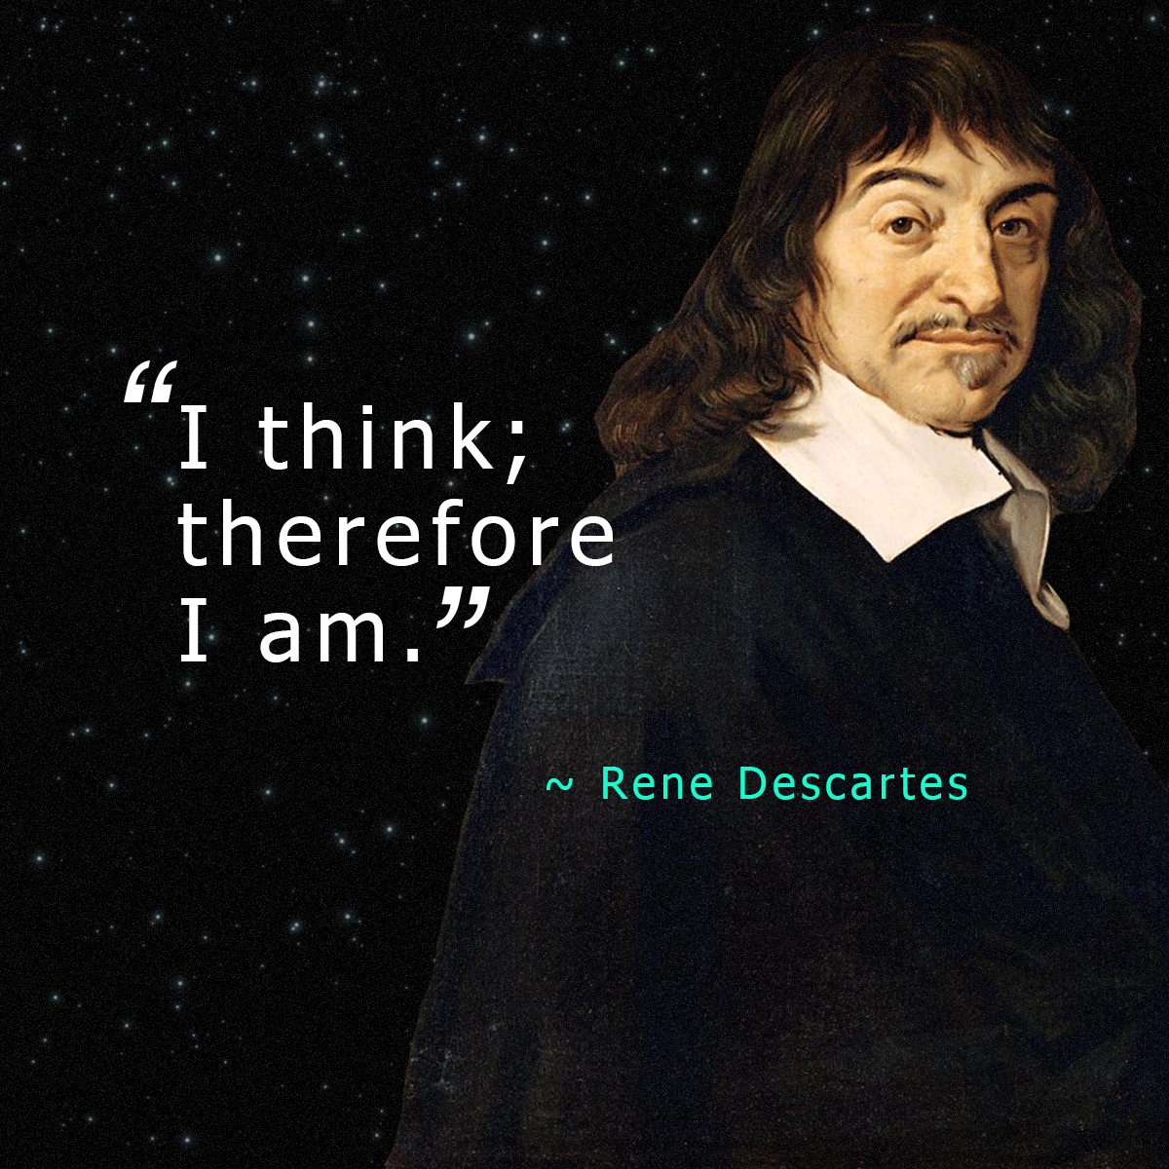
Where did Psychology come from? (4)
Rene Descartes: Dualism
  Mind and Body are not connected
  Mind is spiritual
  Body is material
Dualism led to discussion about what the “mind” is
  The mind itself is not observable or measurable, so does it exist and if so, how does it function?
  Is it worth studying if we can’t physically see it?

Slide 6
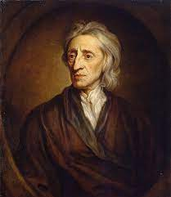
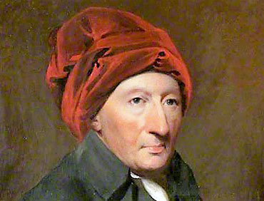
From Philosophy to Science (1)
John Lock (1632 – 1704) and Thomas Reid (1710 – 1796) promoted empiricism
Empiricism == idea that all knowledge comes from experience
Emphasized the role of the human observer in how the mind acquires knowledge
  Study by observing/watching

Slide 7
Early approaches: Graphology
Study of hand-writing to reveal personality characteristics
Popularized in the 1830’s in France
Still persists in popular culture
  Different from handwriting analysis (which looks for forgery)

Slide 8
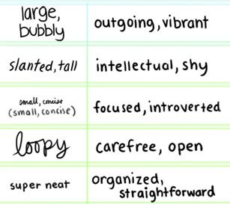
Thought???

Slide 9
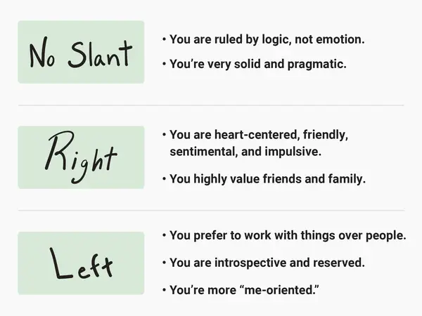
Graphology
Does handwriting reveal personal traits?

Slide 10
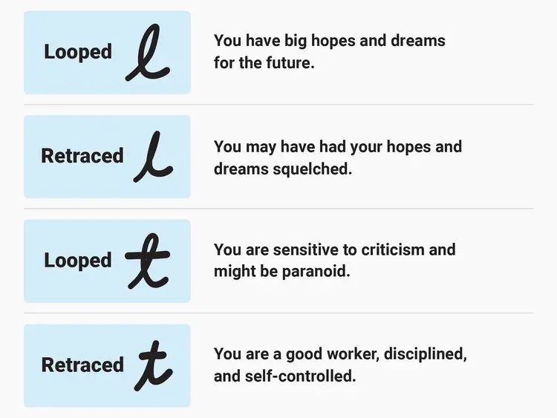
Graphology

Slide 11
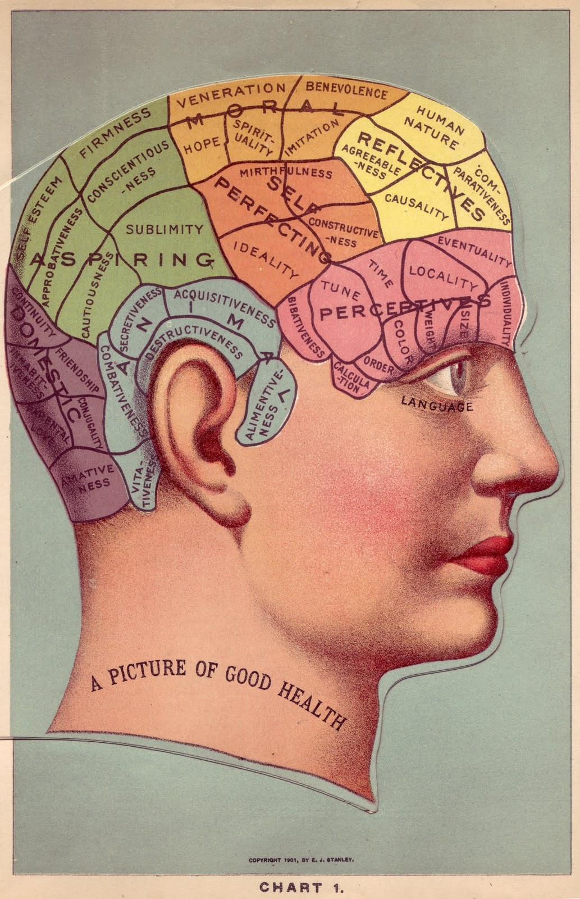
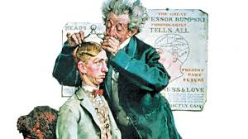
Phrenology (1)
Phrenology: Function (behavior) is housed in specific areas of the brain
  Behavior-structure mapping
  Indentations in your scalp indicate abilities you possess
Franz Joseph Gall (1758 – 1828)

Slide 12
Phrenology (2)
Vaught’s Practical Character Reader (1902)
Allowed anyone to identify a person’s character traits based solely on the shape of their head and facial features
  “Cruel eyes”
  “Selfish ears”
  “Gross, sensual chins”

Slide 13
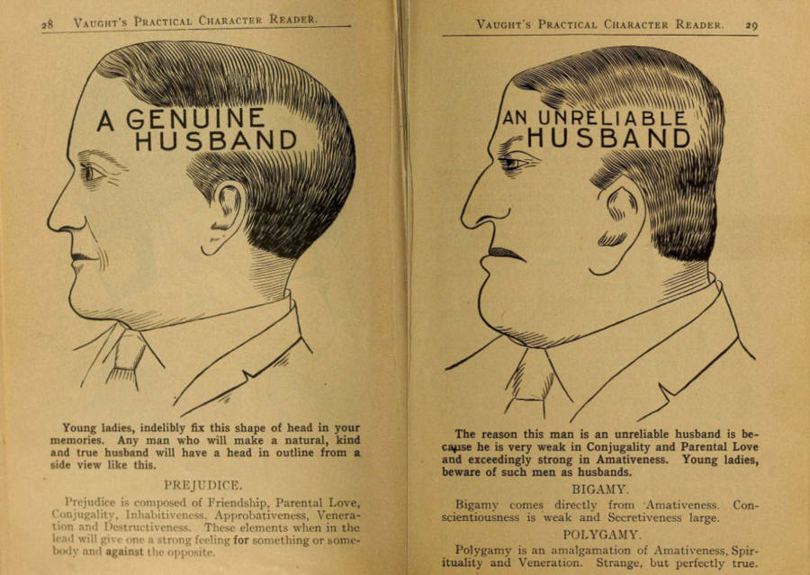
Phrenology (3)

Slide 14
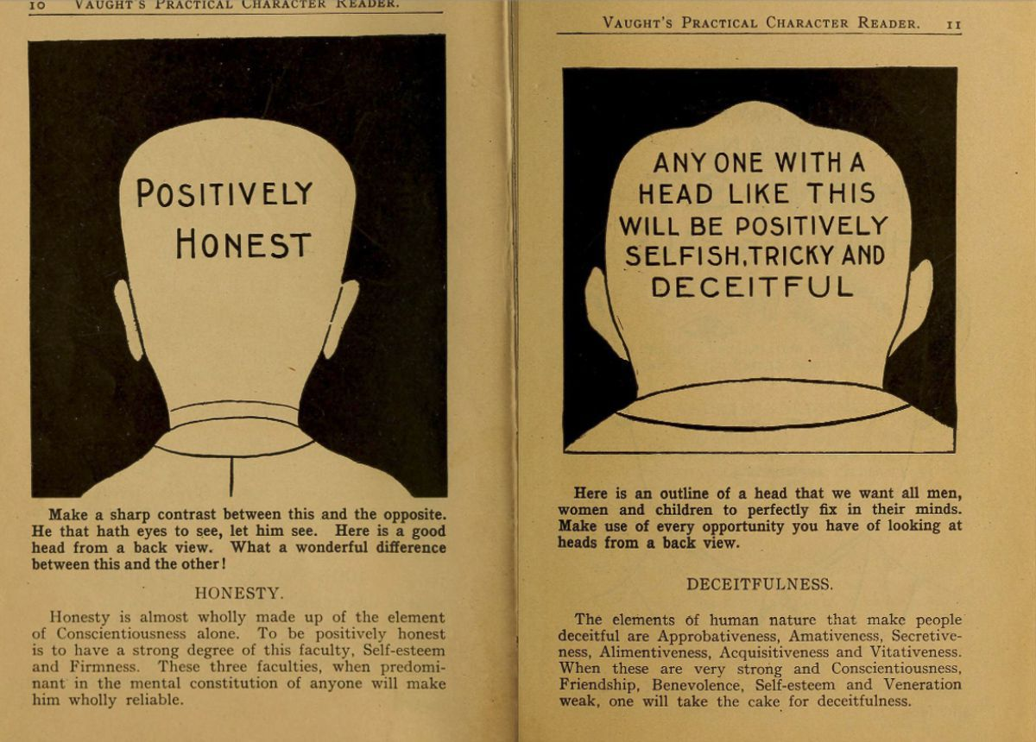
Phrenology (5)

Slide 15
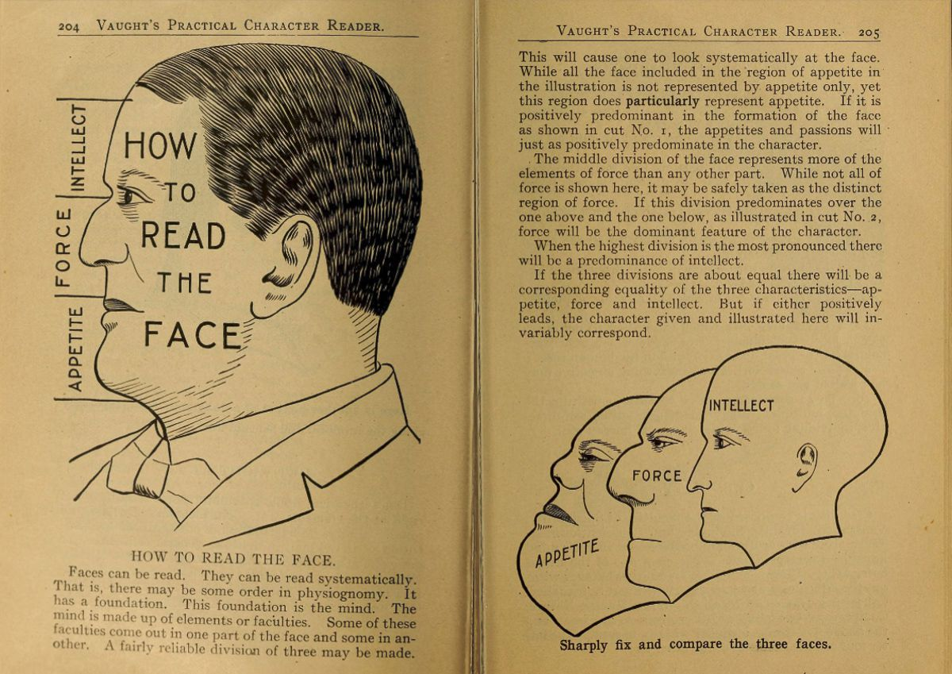
Phrenology (4)

Slide 16
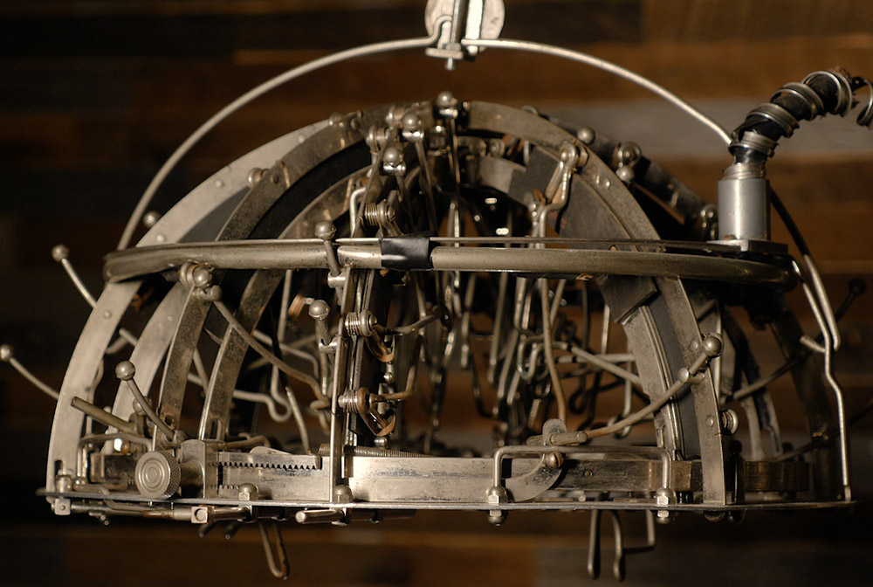
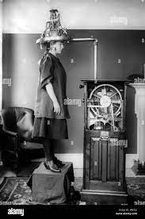
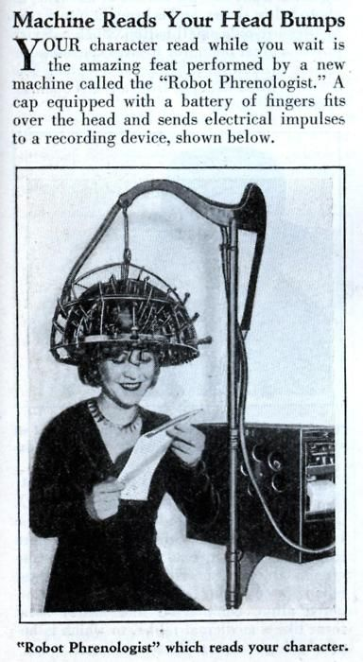
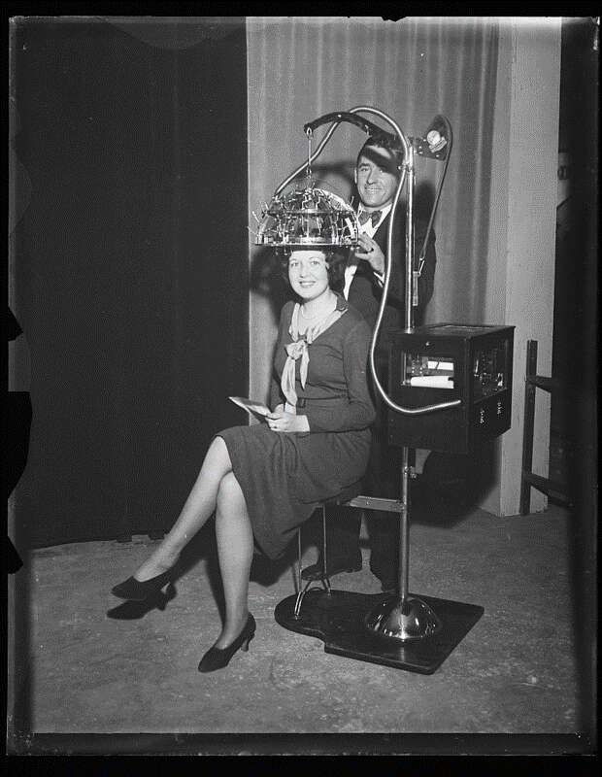
Phrenology (6)
Persisted into the 20th Century! (1950s)

Slide 17
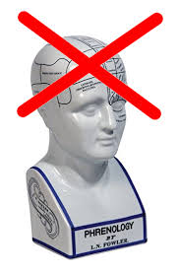
Phrenology and Graphology
Example of Pseudoscience!
  A collection of beliefs or practices mistakenly assumed to be based on the scientific method
How to identify pseudoscience?
  Skepticism and critical thinking!

Slide 18
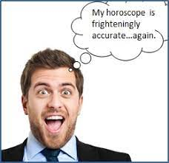
Why are Graphology and Phrenology appealing?
Easy to interpret (makes for a good story)
  Having big hopes and dreams == looping your L’s
It looks scientific; claims remarkably specific results
The Barnum Effect: Tendency to accept information as true, even when the information is vague and worthless

Slide 19
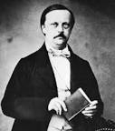
From Philosophy to Science (2)
Research on physiology began investigating the nervous system (19th century)
Hermann von Helmoltz (1821 – 1894)
  Measured the speed of neural impulses
  Also interested in hearing and vision

Slide 20
Hermann von Helmholtz
Research on perception:
  Interested in the relationship between measurable stimuli (like sounds) and their corresponding perception (hearing)
  Put another way, interested in the relationship between physical and mental properties
Showed that our senses can deceive us! There’s a disconnect from the physical and mental worlds

Slide 21
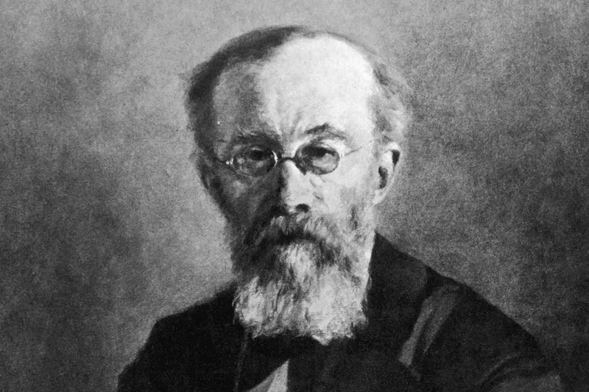
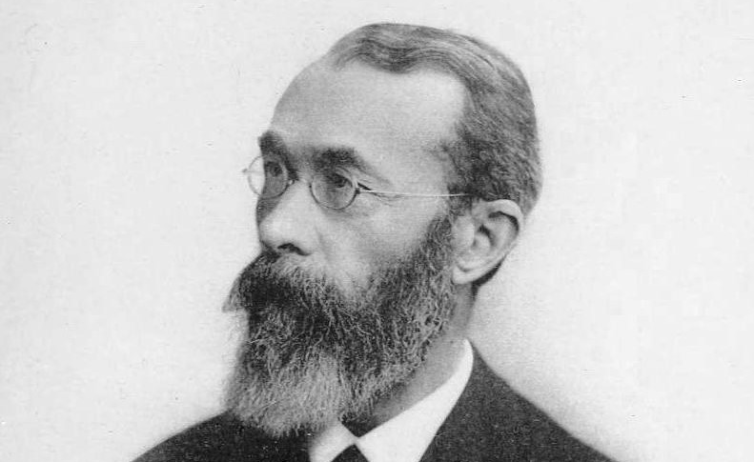
Wilhelm Wundt (1832 – 1920)
Considered the father of modern psychology
Promoted the idea that psychology could be an experimental field

Slide 22
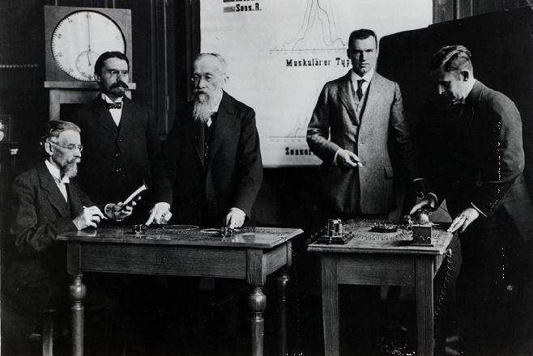
Transition to Empiricism
Wilhelm Wundt
  Established the first Psychology laboratory (Germany, 1879)
  Reaction time experiment: Time between the presentation of a sound and tapping a telegraph
  How long does it take information to travel through the nervous system?

Slide 23


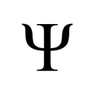
Psychology in the United States
G. Stanley Hall (Wundt’s student)
  First Psychology lab in the US (John’s Hopkins)
  Published first US-based Psychology Journal (1887)
    American Journal of Psychology
  Helped to establish the American Psychological Association (APA)

Slide 24
Transition to Empiricism
Wundt and his students believed in the study of consciousness
  An individuals reportable (measurable) experiences in the world around them
  The “unconscious” mind, was essentially unsuitable for study
    Can’t study what you can’t measure!
  Structuralism: determining the basic elements of consciousness (the mind)
    What physical parts make up the mind?
    Relied on introspection!

Slide 25
Introspection (1)
Introspection == examining ones own conscious experience as objectively as possible
Individuals would be placed in a lab setting, exposed to stimuli (e.g., sounds) and asked to think about what was going on mentally as the events took place
“Arm-Chair Soul-Searching”

Slide 26
Introspection (2)
Benefits
  Great source of personal knowledge
  Helps people make connections between different experiences
Criticisms
  Individual differences! People respond differently to the same stimuli
  Highly subjective!

Slide 27
Problems with Wundt’s Structuralism
Too subjective, two people could experience the same event, but have two completely different experiences
Introspection is also subjective
Science requires reliable observations
Not possible to identify elements of consciousness through introspection alone
“Thinking about your own consciousness”

Slide 28
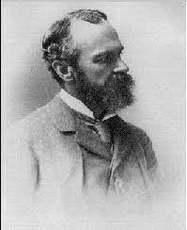
William James (1842 – 1910)
“Psychology is the study of mental life”
  Opposite of Wundt and Structuralism!
Interested in the why and not the what

Slide 29
William James and Functionalism
William James pioneered functionalism
Functionalism == an early school of psychology that probed the purpose and functions of the mind
  Opposes Structuralism

Slide 30
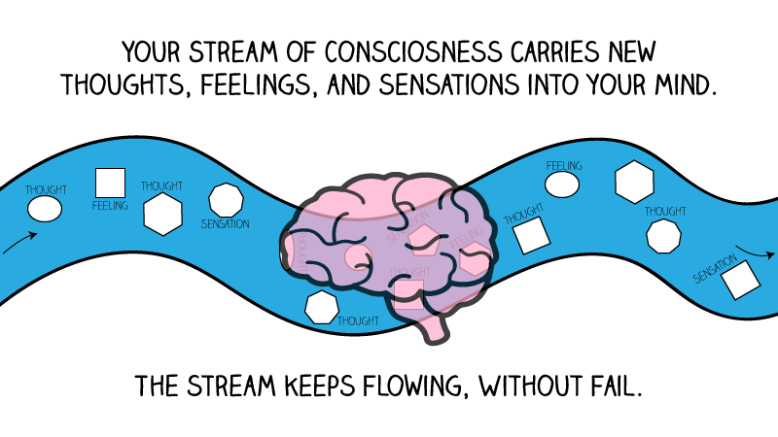
Stream of Consciousness
James believed that consciousness is continuous and ongoing – it cannot be broken into constituent pieces like structuralists believe
  Stream of consciousness – the natural flow of human thought

Slide 31
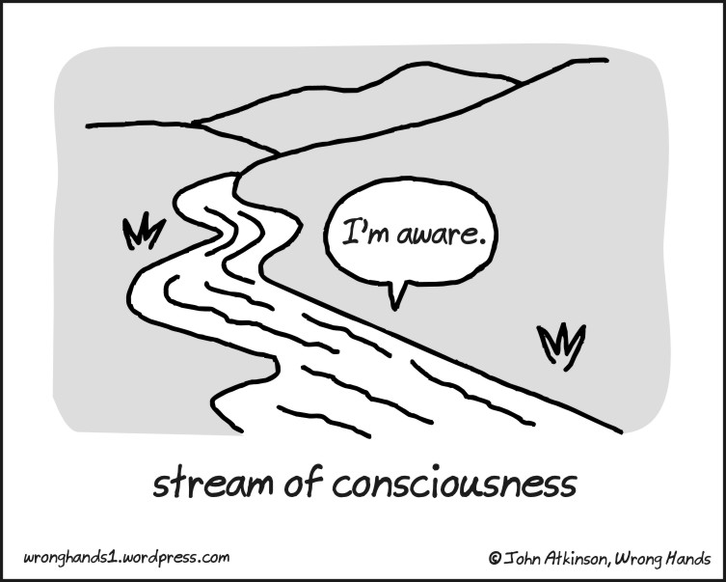
Stream of Consciousness
Metaphor for how we perceive the world around us
  We experience the world one mental event a time
  Mindfulness == moment-to-moment awareness of one’s subjective, conscious experience

Slide 32
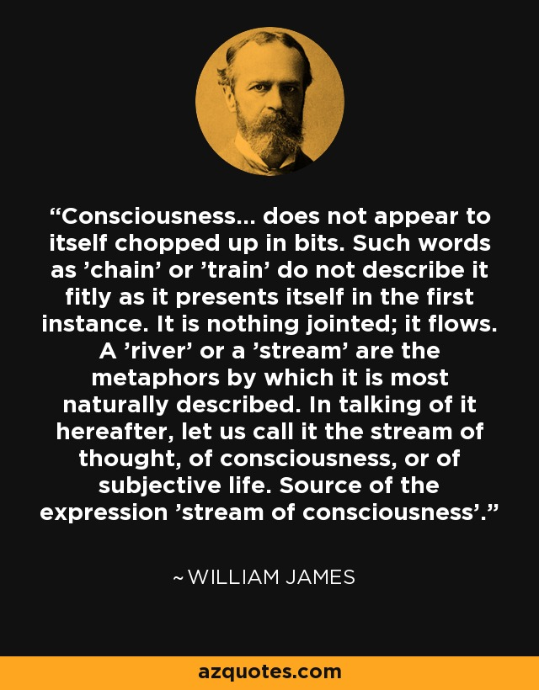

Slide 33
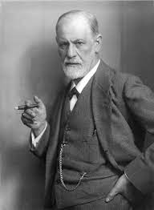
Sigmund Freud (1856 – 1939)
Austrian neurologist and founder of the psychoanalytic approach
Originally was trained in medicine, with a specialization in neuropathology
Very interested in the medicinal benefits of cocaine

Slide 34
Sigmund Freud (1856 – 1939)
In late 1885, Freud moved to Paris and began work in neuropathology clinic
  Primarily studied female patients suffering from hysteria
Freud believed that psychological disorders had their source in the mind rather than the brain
  Unconscious desires drive behavior
    Focused on sex drives
    Also repressed memories, childhood trauma, etc.

Slide 35
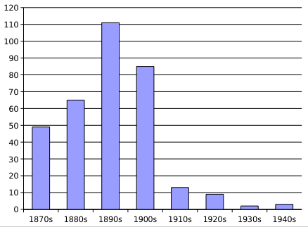
What is Hysteria?
Hysteria == Exaggerated or uncontrollable emotion or excitement
In the 1800’s: Used as a “catch-all” term for disorders that couldn’t be explained
  Conveniently affected women most often
Not really a thing these days
  Better understanding of psychological disorders/mental health
Published Theses on Hysteria

Slide 36
Sigmund Freud (1856 – 1939)
Psychoanalysis == treatment of mental disorders by investigating the interaction of conscious and unconscious elements
Key question: Do childhood problems influence adult behaviors?

Slide 37
Origins of Psychoanalysis: The case of Anna O. (1895)
Suffered from hallucinations, Headaches, paralysis, and speech problems
  Dubbed “Hysteria” back in the day
Treated by Freud’s colleague Josef Breuer
Her treatment served as the basis for psychoanalysis

Slide 38
Anna O. (Background)
Anna O. was an Austrian woman who lived in the 19th century (born 1859 in Vienna)
Younger sister died from tuberculosis in 1867 (Anna was 8 years old)
In 1880 her father contracted TB; Anna was tasked with caring for him

Slide 39
Anna O. (Background)
In 1881, Anna’s father passed away
Anna soon fell sick, but with different symptoms
  Headaches, paralysis, hallucinations, etc.

Slide 40
Anna O. (Treatment)
Sought treatment from Josef Breuer
  “The talking cure” – engaged Anna in conversation
  Involved having her talk about her problems in search of a psychological basis for her afflictions
  She would tell stories often mirrored her childhood experiences (unconscious motives?)
    Example: Caring for a sick individual

Slide 41
Anna O. (Treatment)
Breuer and Freud believed that having Anna discuss unconscious anxieties would help her overcome her symptoms
She eventually recovered, which led to an emphasis on the impact of past trauma and the role of the unconscious mind

Slide 42
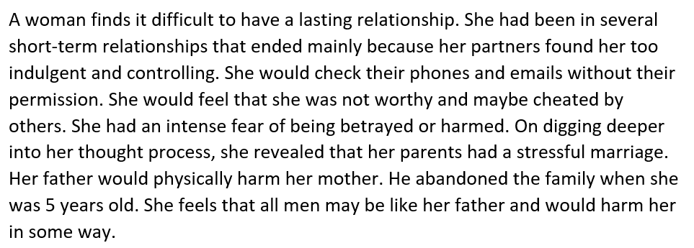
Psychoanalysis Example

Slide 43
Problems with Psychoanalysis
Based on the “unconscious mind”
  Very hard to test!
Focuses on the individual being the problem
  Ignores social problems

Slide 44
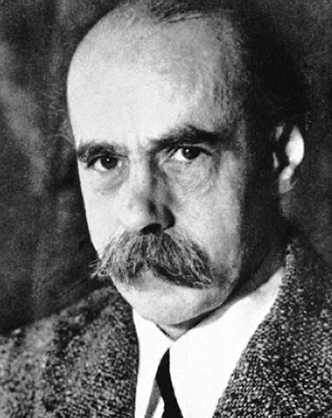
Gestalt Psychology
Began in Germany with the work of Max Wertheimer (1880 – 1943)
Believed that studying the whole of any experience was better than studying the individual pieces
  Recall that Wundt’s structuralism was focused individual “pieces” of consciousness

Slide 45
Gestalt Psychology
Example: A melody is more than just the collection of notes that comprise it
Gestalt psychologists proposed that the mind worked similarly
  Example: Viewing a photograph you see a whole image, not a collection of individual pixels

Slide 46
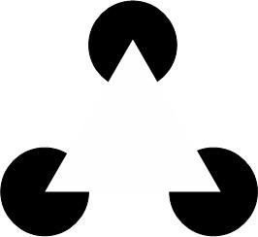
Example -- Closure
The human eye will fill in missing details on pictures

Slide 47
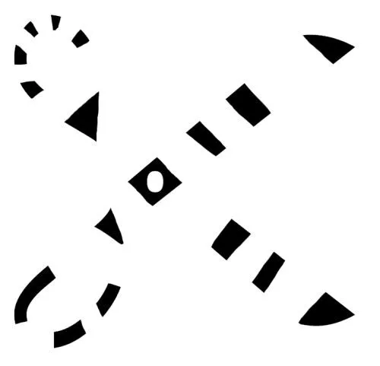

Slide 48

Example -- Proximity
We use distance to group objects together

Slide 49

Figure Ground Relationship
We segment the visual world into objects/figures and the ground that they are placed on

Slide 50
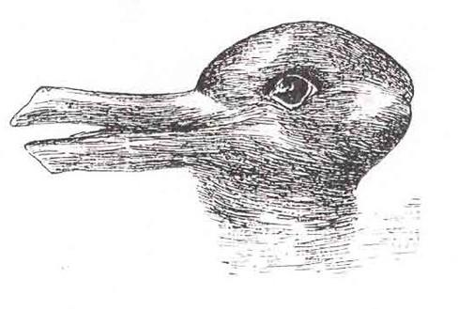

Slide 51
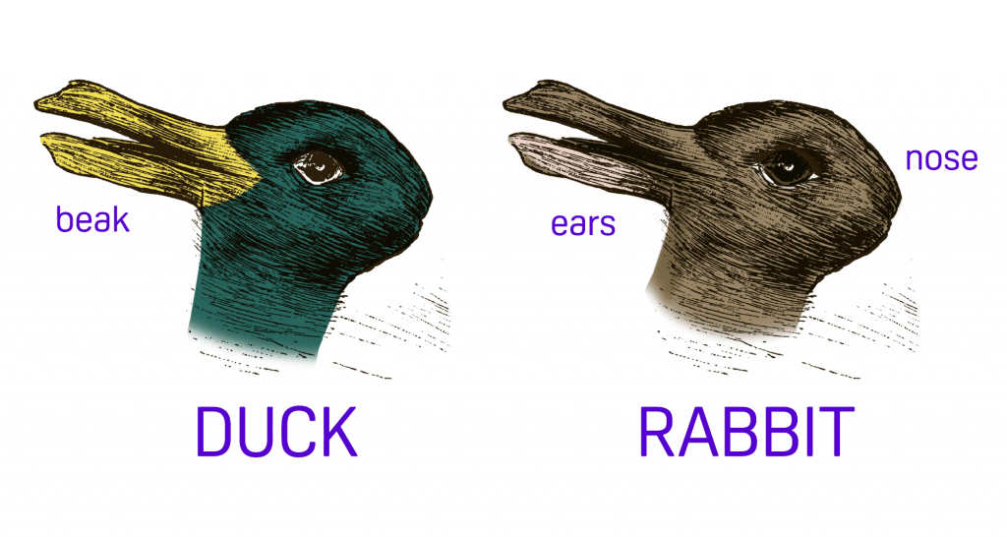

Slide 52
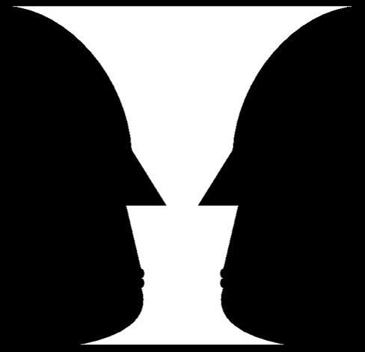

Slide 53

Example – Law of Continuity
How many do you see lines?
Law of Continuity == We are more likely to perceive continuous shapes than jagged, broken lines

